Slide 1


Git Installation
myshow4all​

Slide 2
Agenda

Slide 3
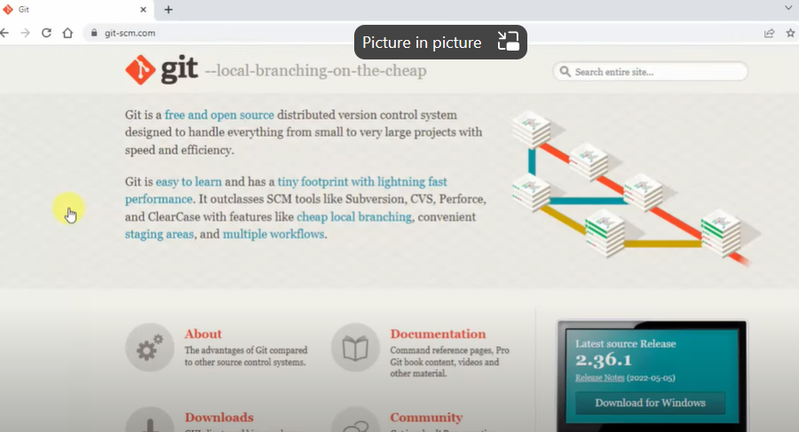
Agenda

Slide 4
Agenda

Slide 5
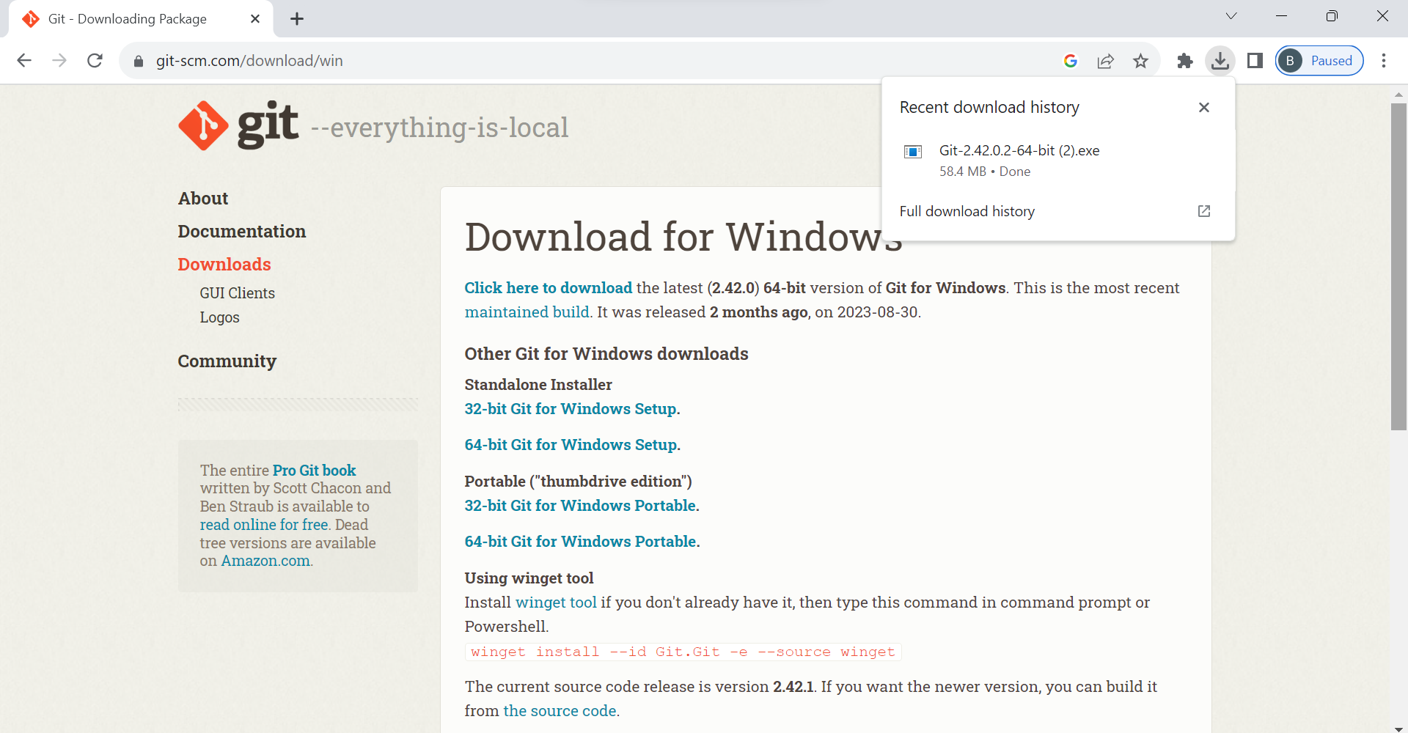
First, click here
Then, double click here

Slide 6
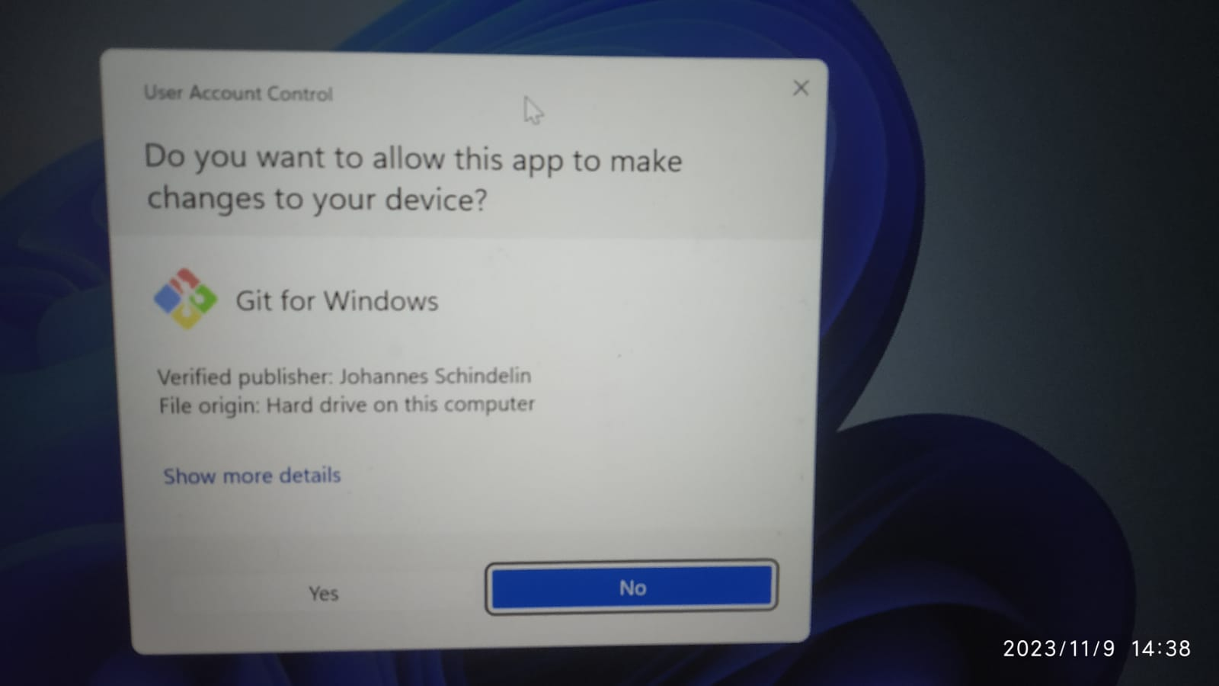
Click “Yes”

Slide 7
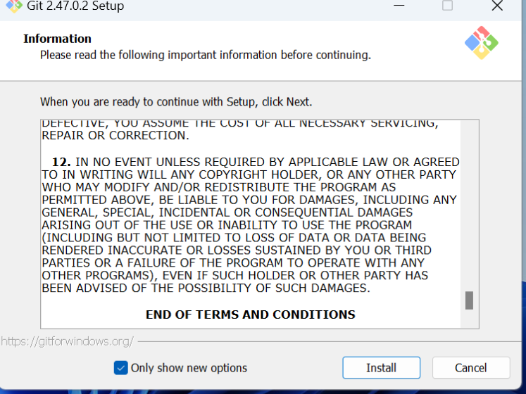

Slide 8
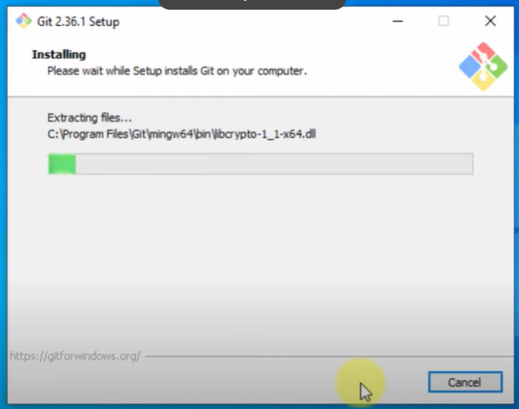
Agenda

Slide 9
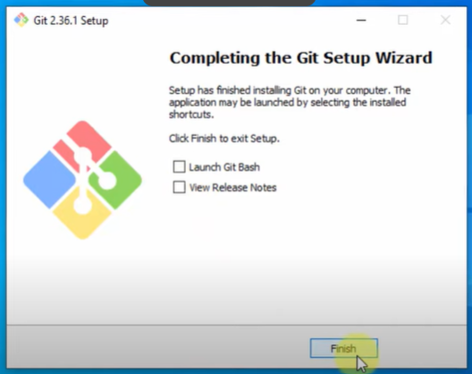
Agenda

Slide 10
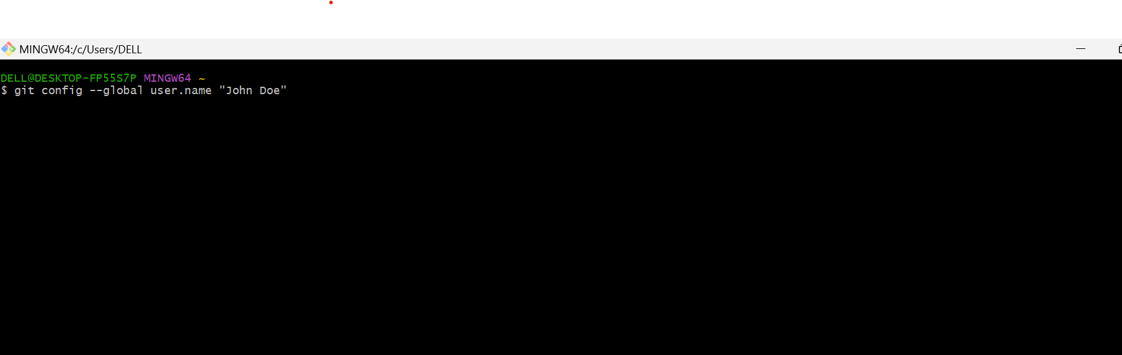
Git Global Configuration – User Name
Open Git Bash and enter the following:
Enter your name

Slide 11
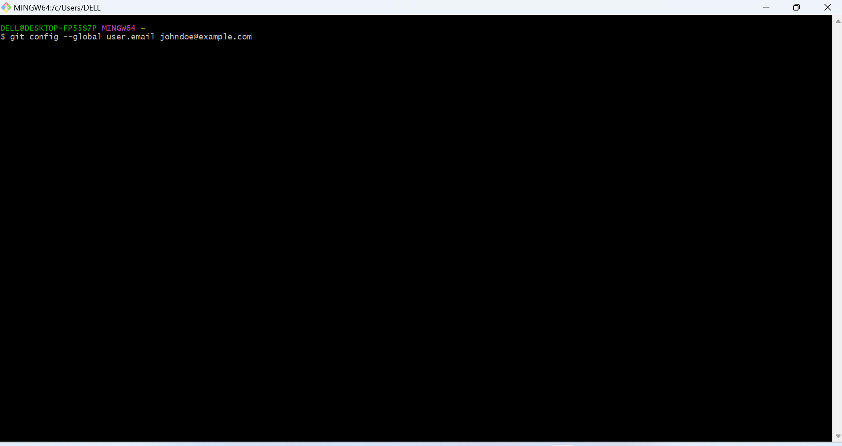
Git Global Configuration – Mail ID
Open Git Bash and enter the following:
Enter your mail id
Enter your name

Slide 12

Meet our team
Krishna
Sunil
Vamsi
Vijay
Project Manager
Chief Executive Officer
Branch Manager
VP Marketing

Slide 13


Thank you
MYSHOW4ALL.COM

